Slide 1


CryptoGuard AI – Ethereum Wallet Fraud & Anomaly Detection System
BDAT 1004 – Blockchain Project
Tirth Rakeshkumar Doshi – 200609650
Chang Liu – 200652377
Darshit Manojkumar Limbachiya – 200611012
Kusuma Sree Addageethala – 200600636
Instructor: Prof. Robin Huang
Notes:
Good morning/afternoon everyone, today our team presents CryptoGuard AI, a machine-learning powered Ethereum wallet analysis tool that detects suspicious on-chain behavior.

Slide 2
The Challenge: Rising Crypto Fraud & Wallet Risks
Crypto scams, phishing, and laundering are increasing every year
Users often transfer funds to unknown wallets without safety checks
Existing tools are expensive, complex, or not user-friendly
Need for real-time anomaly detection to prevent losses
Notes:
Cryptocurrency adoption has increased, but so has fraud. Many users have no tool to verify if a wallet is safe before interacting with it. Our goal is to solve this problem.

Slide 3
Our Solution: CryptoGuard AI
Fetches real-time Ethereum transactions
Engineers behavioral features for each wallet
Uses ML (IsolationForest) to detect anomalies
Provides a risk score (0–100) and risk category
Visualizes patterns with dashboards & charts
Notes:
Our system provides immediate insights into wallet behavior using ML-powered analytics, accessible through a clean web interface.

Slide 4
System Architecture Overview
User
Data Ingestion (Etherscan API)
Feature Engineering
ML Model
Risk Score
CSV Export
Power BI
Streamlit UI
Charts + Tables
Notes:
This diagram summarizes the full workflow: user inputs a wallet, we fetch data from Etherscan, generate features, run ML algorithms, and visualize results.

Slide 5
Real-Time Blockchain Data Ingestion
Source: Etherscan API V2 (txlist)
Extract: Hash, timestamp, value, fees, sender/receiver
Standardize into DataFrame
Store raw data for analysis
Notes:
We use Etherscan's V2 API to fetch the most recent 150 transactions for each wallet. This raw data is then cleaned and structured.

Slide 6
Feature Engineering for Wallet Behavior
Features Used:
  Transaction Count
  Total Volume (ETH)
  Average / Maximum / Minimum Tx Value
  Average Gas Fee
  Burstiness (Tx per hour pattern)
  Average Time Between Transactions
Notes:
We convert raw blockchain data into meaningful behavioral patterns. These features help the model distinguish normal wallets from suspicious ones.

Slide 7
Machine Learning Model
Points:
  Works with unlabeled data
  Detects rare or unusual patterns
  Outputs anomaly score
  Converted to risk score (0–100)
  Categories: Low / Medium / High
Notes:
IsolationForest is ideal because blockchain data doesn't come with labels. The model isolates unusual wallets by scoring their behavior.

Slide 8
Streamlit Application
Key App Features:
  Real-time scoring
  Transaction charts
  CSV export
  Clean and interactive UI
Notes:
Our front-end is built in Streamlit, making it simple for users to analyze any Ethereum wallet instantly

Slide 9
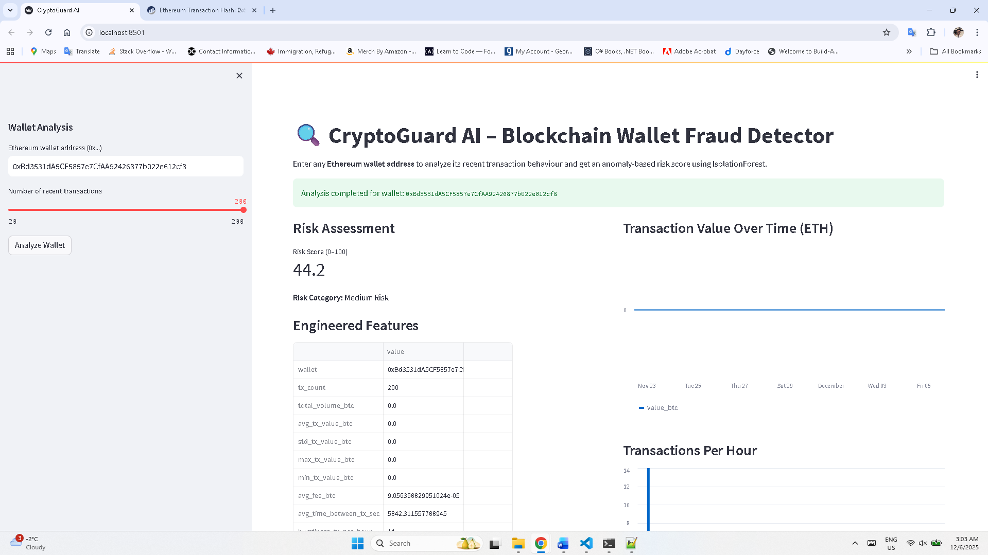
Streamlit Application
Notes:
Our front-end is built in Streamlit, making it simple for users to analyze any Ethereum wallet instantly

Slide 10
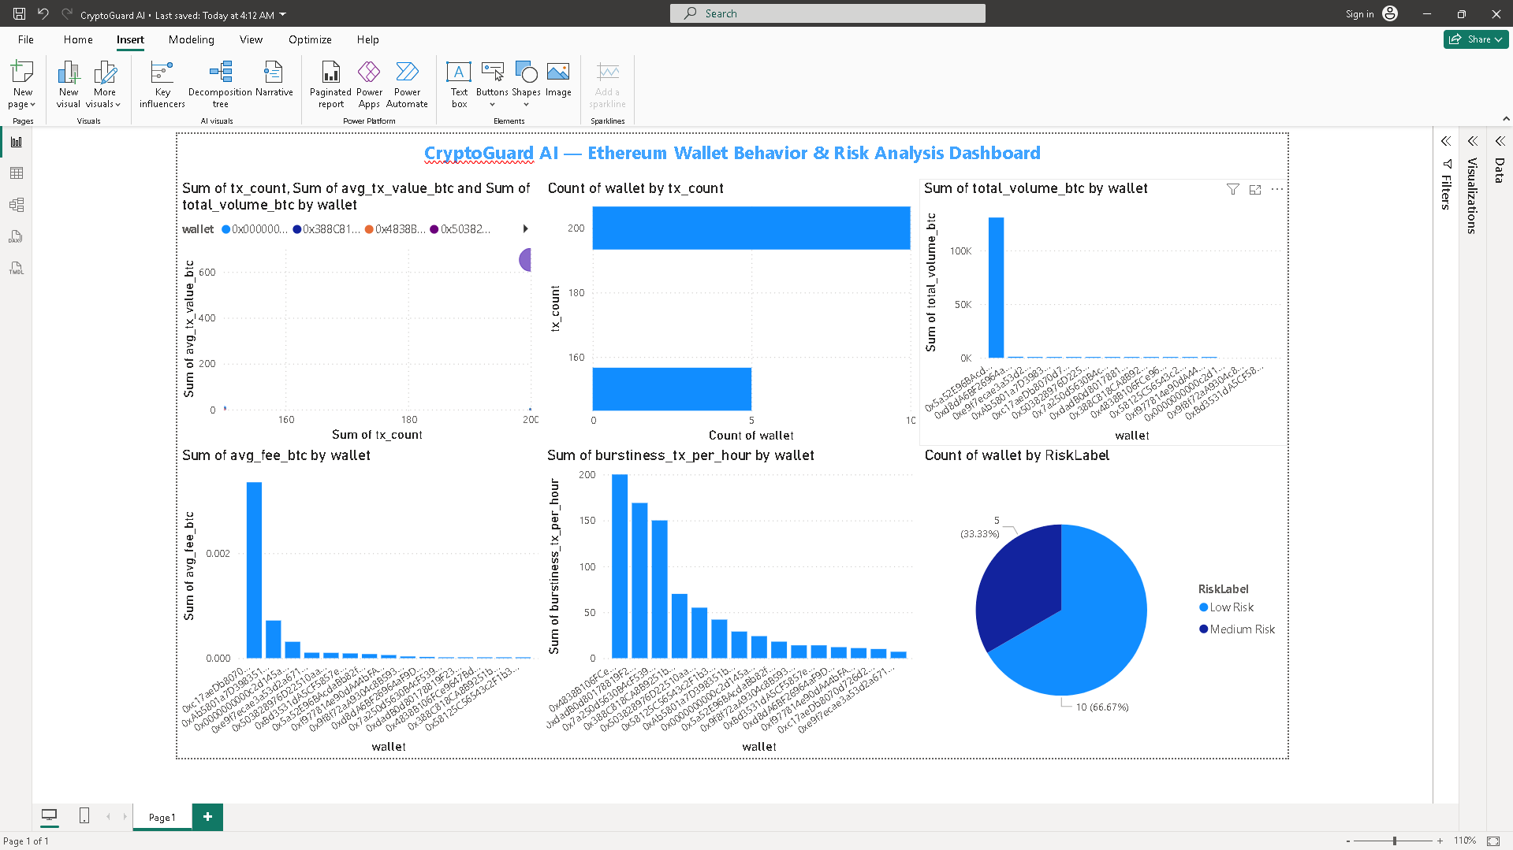
Power BI Dashboard
Transaction volume per wallet
Transaction count
Burstiness score
Scatter plot (tx_count vs
avg_tx_value)
Risk distribution pie chart
Notes:
"Power BI provides deeper visualization of wallet behavior clusters and anomalies. This dashboard is useful for compliance, exchanges, or analysts."

Slide 11
Results & Insights
High-volume wallets behave differently from high-burstiness wallets.
Some wallets have unusual fee patterns.
Behavioral clustering reveals potential automated or bot wallets.
Risk categories help differentiate normal vs suspicious behavior
Notes:
"Using the charts, we can identify which wallets stand out due to high burstiness, extreme volume, or unusual behavioral signatures."

Slide 12
Limitations & Future Enhancements
Points:
  IsolationForest accuracy depends on variety of training wallets
  Only Ethereum chain supported
  Real-time alerts not yet implemented
Future Enhancements:
  Multi-chain support (BTC, BSC, Polygon)
  Live alerting (Telegram/Discord bot)
  Cloud deployment (Azure/AWS)
  API service for external apps
  Advanced ML models (Autoencoders, LSTM)
Notes:
We plan to expand CryptoGuard AI into a multi-chain intelligent risk engine with improved ML algorithms.

Slide 13
Conclusion
CryptoGuard AI detects wallet anomalies using ML
Helps prevent risky transfers
Provides fast, accessible blockchain intelligence
Delivers insights through dashboards & real-time scoring
Notes:
In conclusion, CryptoGuard AI brings machine-learning powered risk analysis to blockchain users, making crypto transactions safer

Slide 14

Thank You!

